Slide 1



UNITED AIRLINES
HACKATHON
Fly the Friendly Skies
KHUSHI JAIN
ARYAN SHUKLA
Department of Computer Science
University of Delhi

Slide 2



DELIVERABLES & WORKFLOW
Data Preprocessing
Key Factors contributing to extended call durations Key drivers of long AHT and AST quantify the percentage difference between the average handling time for the most frequent and least frequent call reasons
Analyze Call Duration
Sentiment and Tone Analysis
Silence Percentage Analysis
Analysing transcripts and call reasons to identify granular reasons that could be resolved via self-service options in the IVR system. Improvements to the IVR options to effectively reduce agent intervention in these cases.
Call Reason Analysis
Agent Performance Evaluation
Customer Loyalty Impact
Understanding the primary reasons for incoming calls and accurately categorizing call reasons.
Insights Generation
Recommendations

Slide 3

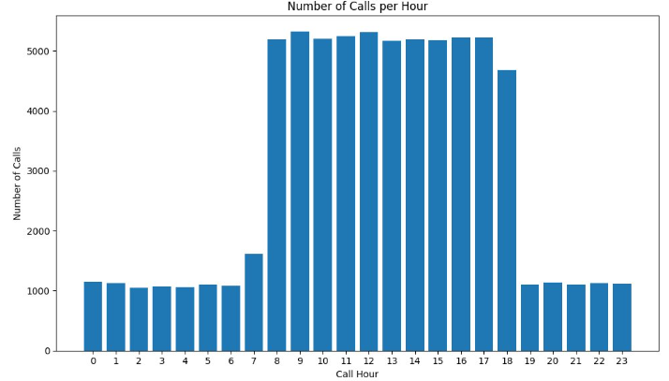
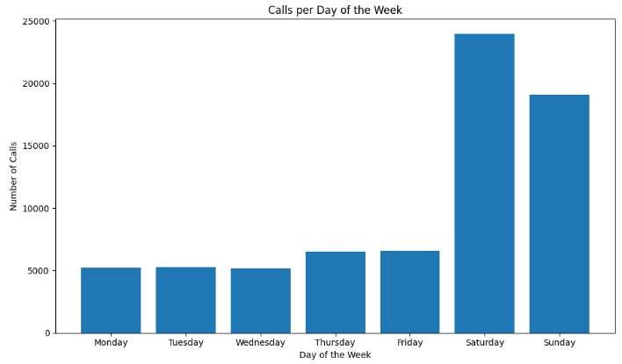

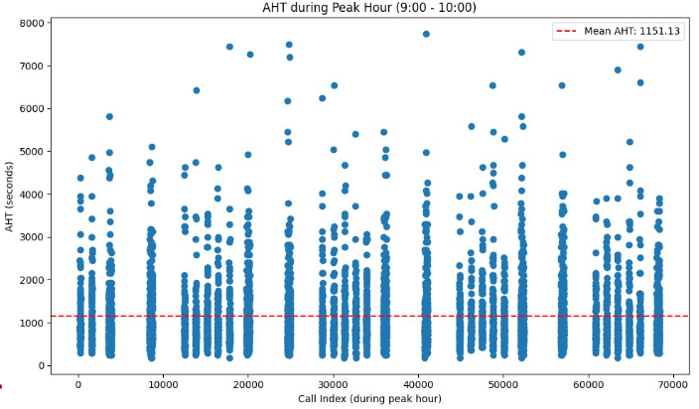
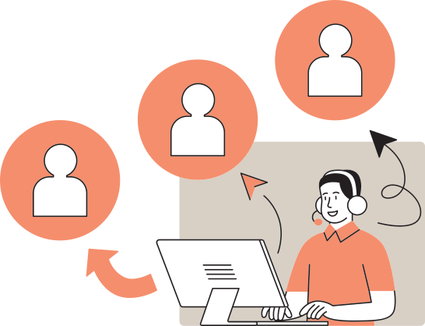
1.1 HIGH VOLUME CALL PERIOD
Staffing Needs : - Can schedule more agents during peak times to reduce wait times and improve customer satisfaction.
Cross-Channel Integration :- can consider increasing support on other channels (like chat or email) during these times to provide a seamless customer experience.
Peak range is 9 AM - 6 PM
Maximum calls received
on Saturday
During peak hours majority calls have AHT less than mean AHT, implies straight forward queries that can be routed through IVR

Slide 4
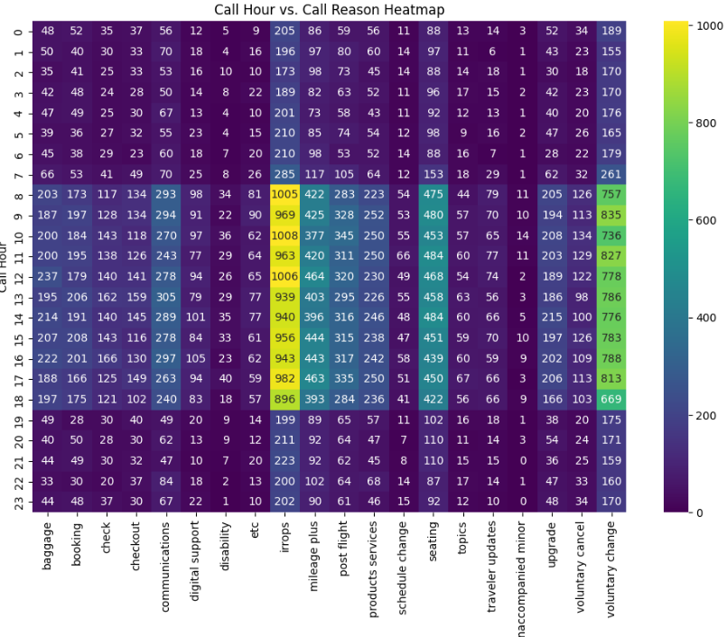
1. Operational Disruptions Impact: Irregular operations (irrops) generate the highest call volumes, indicating a need for better customer communication during disruptions.
2.Loyalty Program Confusion: High call volumes for "mileage plus" suggest frequent customer queries, highlighting the need for clearer information or self-service options.
3.Predictable Call Peaks: Voluntary and schedule changes show periodic spikes, pointing to predictable customer behavior, helpful for planning resources.
4.Improvement Opportunities: Fewer calls in categories like "digital support" and "checkout" may indicate either a smooth process or low service awareness, warranting further exploration.
This heatmap shows the distribution of primary call reasons across different time periods. Darker shades represent higher call volumes for specific reasons, such as "irrops" and "mileage plus," which stand out as the most common reasons for calls. Call volumes for categories like "voluntary change" and "seating" are also prominent in certain time frames. The graph highlights peak call volumes during specific intervals for different service issues.

Slide 5
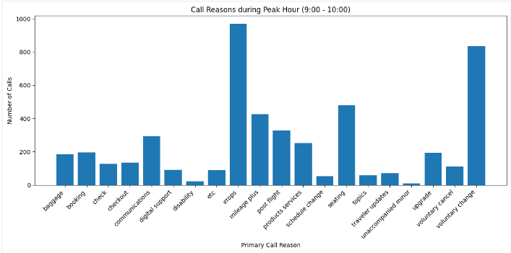
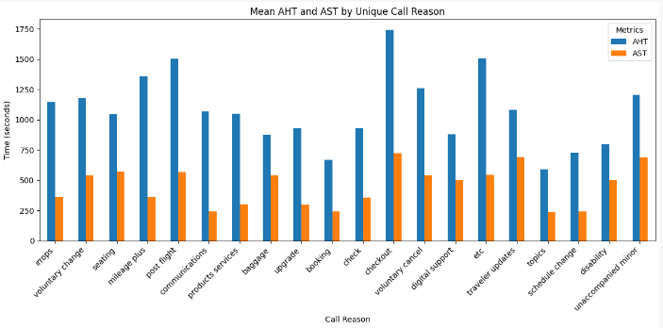
Maximum calls during peak hour are related to irrops and voluntary change.
Proactive Communication: Enhance proactive communication strategies during these peak times to inform customers about irrops and minimize confusion or frustration, it can include:-informed mai,Informed IVR calls,informed watsapp and normal SMS.
Real-time Updates: Real-time updates functionality in website regarding irrops can help keep customers informed and potentially reduce the number of calls.
1.2 KEY DRIVERS OF LONG AHT AND AST
Checkout related queries require the most time to handle and have the longest wait times, while topics is dealt with most efficiently. These insights can guide resource allocation and process improvements in the call center to enhance overall service efficiency.

Slide 6
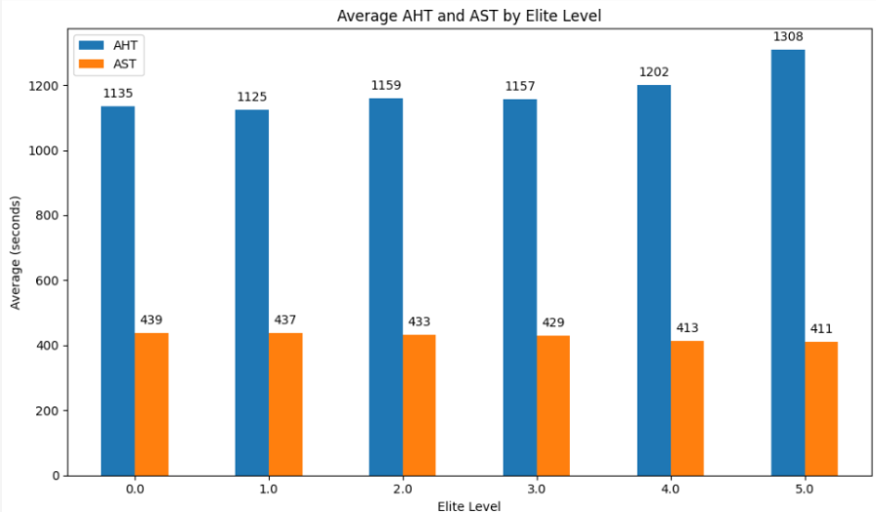
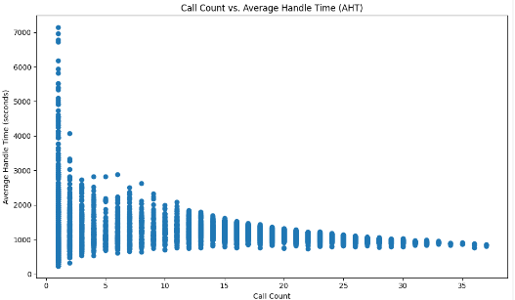
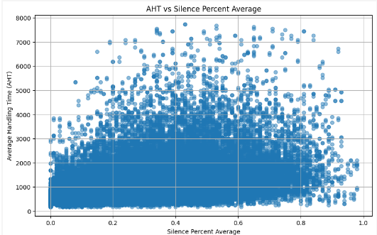
AHT is directly proportional to customer elite level code
AST is inversely proportional to customer elite level code
Thus some maximum time limit criteria should be kept so that after maximum duration client’s call is disconnected and is connected later after peak hours, this will also reduce AST
If AHT of call is less this allows agent
to handle more calls
For higher AHT silent percentage is more implies agent takes too much time to ans query

Slide 7
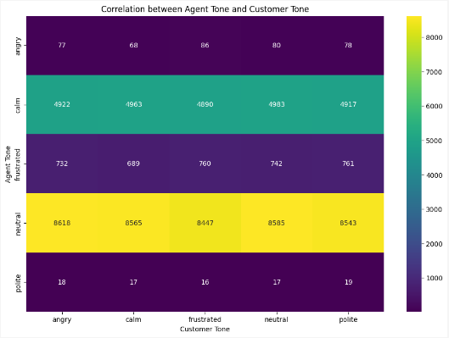

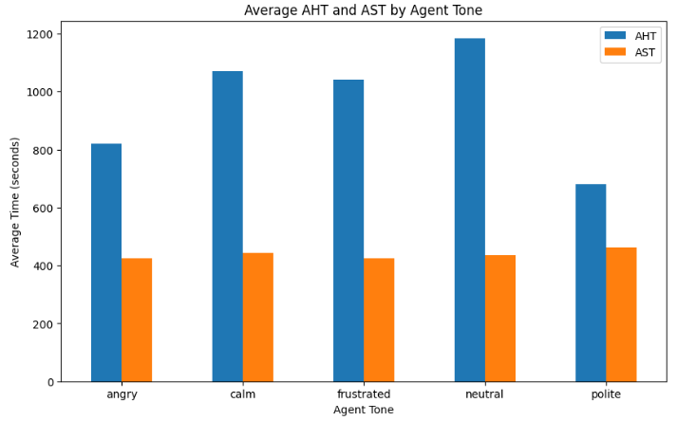
Neutral and Calm Interactions dominate, with agents often responding in a neutral or calm tone, regardless of the customer's tone.
Frustrated or Angry Customers are relatively rare, and even then, agents typically stay calm or neutral, demonstrating professionalism.
Polite Interactions are the least frequent, suggesting that politeness is less common from both sides during calls.
Calm Responses from agents are most common when the customer is calm, showing alignment between customer and agent demeanor in these cases.
Train agents on tone : Focus on training agents to maintain a positive tone when interacting with members to enhance satisfaction and loyallty
Agents who are polite seem to resolve issues the fastest, likely because customers may feel more comfortable and satisfied, leading to quicker resolutions.
Agents with a neutral tone have the longest handle times, suggesting that a neutral approach may not engage the customer as effectively, leading to more drawn-out conversations.

Slide 8
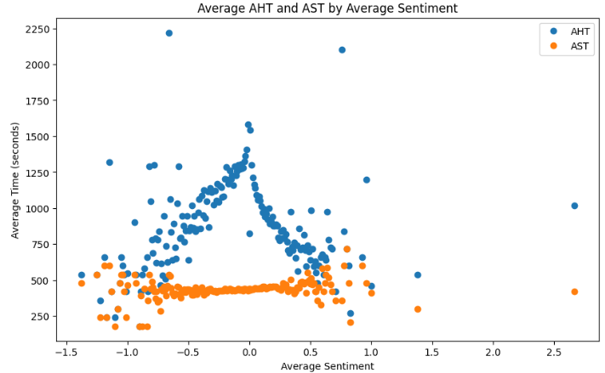
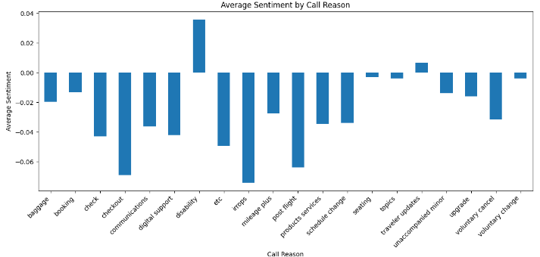
Handle time varies most when conversations are neutral or slightly negative, suggesting indecision or complex issues.
Extremely negative or positive sentiments lead to quicker resolutions, possibly due to clearer customer needs.
Waiting time remains stable across all sentiment levels, showing no impact of sentiment on wait duration.
Negative Sentiment Drivers: Categories like checkout, digital support,irrops and post flight have the most negative sentiment, indicating customer dissatisfaction, likely due to service disruptions or technical issues.
Positive Sentiment Areas: Disability and traveller updates have slightly positive sentiments, suggesting good handling or satisfactory outcomes in these areas.
Neutral/Low-Impact Reasons: Categories such as upgrade, voluntary change, and seating show relatively neutral sentiment, indicating fewer emotional reactions or well-handled requests.
Focus for Improvement: The negative sentiment in core service areas like irrops and checkout suggests potential for improvement in customer support and communication during disruptions.

Slide 9
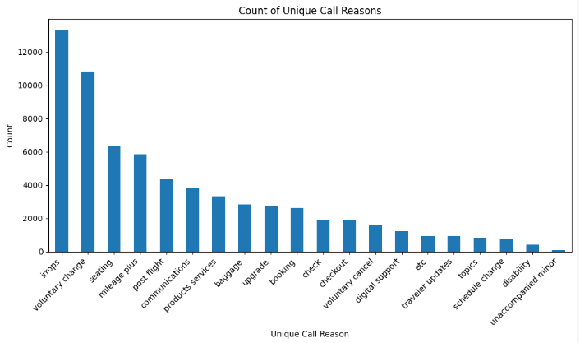

1.3 PERCENTAGE DIFFERENCE AHT FOR MOST FREQUENT AND LEAST FREQUENT CALL REASONS
Percentage difference in AHT between most and least frequent reasons: -5.16% -> This indicates that most frequent reason take 5.16 % lesser time on average than those for least frequent reasons
Percentage difference in AST between most and least frequent reasons: -47.68% -> This indicates that most frequent reason take 47.68 lesser speed on average than those for least frequent reasons
Most frequent call reason is irrops
Least frequent call reason is unaccompanied minor

Slide 10
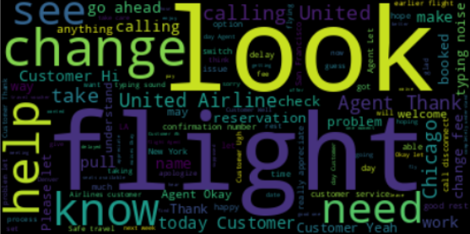
2.1 REASONS THAT COULD BE RESOLVED VIA SELF-SERVICE OPTIONS IN THE IVR SYSTEM
This graph illustrates the distribution of call reasons during the peak hour of 9:00 - 10:00. The most frequent call reason is irrops with nearly 1000 calls, suggesting it may be a catch-all category for miscellaneous issues. Voluntary change is the second most common reason, with over 800 calls. The least common reasons include disability and unaccompanied minor with fewer than 100 calls each. This information could be crucial for staffing decisions, training focus, and potentially streamlining frequently occurring issues to improve overall call center efficiency during peak hours.
Most frequent topics in customer calls are related to flight changes and help requests. Look, change dominate, suggesting that customers are often seeking assistance with booking modifications or flight-related inquiries. City names like Chicago indicates specific destinations being frequently discussed. Additionally, terms like reservation and problem reflect customer concerns about flight management and bookings. This points to a focus on improving self-service options for flight changes and bookings.

Slide 11

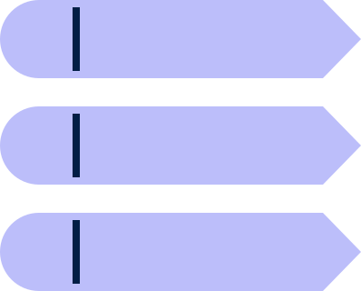


TRAVELLER UPDATES
BOOKING & SEATING
IVR can provide real-time traveller updates, ensuring passengers receive timely information about flight statuses without needing to wait for an agent.
Smart Call Assist
Facilitates faster reservations and seats selection or confirmations
Customer Call Initiated
1
UPGRADE
DIGITAL SUPPORT
Are Agents Available?
If not then
2
CALL REASONS THAT CAN BE HANDLED BY IVR
IVR can guide users through common digital support issues, reducing wait times and helping customers resolve problems independently.
Allow passengers to quickly access available options and promotions
3
Record Customer Message
Transcribe Voice Message to Text
4
Display Response to Customer
7
Smart call assistance approach for handling calls during peak
times
Pass Transcribed Text
to UA’s customised
Chatbot
5
Is Query Resolved?
Yes → End Interaction
8
Chatbot Processes Query and Returns Response
6
9
Thank Customer

Slide 12

2.2 IMPROVEMENTS TO THE IVR OPTIONS TO EFFECTIVELY REDUCE AGENT INTERVENTION
Simplified IVR menu
Proactive IVR Messaging for Common Issues
Offer Enhanced Self-Service for Technical Support
Real-Time Information
Include Emotional and Sentiment Detection
Enhanced Natural Language Processing (NLP)
Multiple nested sub-menus and options leads to confusion
Implement proactive messaging for known recurring issues based on data from previous calls.
Provide step-by-step troubleshooting guides directly in the IVR system for common technical problems.
Ensure the IVR system provides real-time updates on flight status, gate changes, and delays, directly pulling data from airline systems.
Use sentiment analysis in the IVR system to detect customer frustration early in the call and adjust the interaction accordingly.
Implement advanced NLP to allow passengers to speak naturally rather than using rigid commands, making interactions smoother.
3.1 PRIMARY REASONS FOR INCOMING CALLS
Irrops (Irregular Operations)
These situations often involve complex itinerary changes or disruptions, requiring personalized solutions and immediate decision-making by agents.
Seat changes, upgrades, or special seating requests often involve specific availability or preferences that require agents' real-time assistance to meet customer needs.
Seating
Passengers making voluntary changes to their bookings may need advice on fare differences, alternate routes, or other options, which are better handled by a human agent for flexibility.
Queries related to frequent flyer accounts can involve complex adjustments, point redemptions, or discrepancies that require secure, personalized handling by an agent.
Voluntary Change
Mileage Plus

Slide 13
ANALYSING CALL TRANSCRIPTS
Replace punctuation marks with space
Remove leading and trailing spaces
Remove multiple spaces between words
Text
Cleaned Text
Remove Stopwords
Cleaned Transcripts
Extracting features
Using TD-IDF
Applied ML models
Logistic Regressio
SVM
XGboost Classifier
Random Forest
Using LDA
Visual Language model(Qwen-2VL)
Using BERT

Slide 14


SUPPORTING MATERIALS
https://github.com/Aryanshukla206/SKYHACK-2.0-United-Airlines
https://analytics.zoho.in/open-view/386933000000002289
https://analytics.zoho.in/open-view/386933000000002484/abe1285bcde8e21cefe45fa7b53a53e8
https://analytics.zoho.in/open-view/386933000000002365/10346093683cef243cb6ed995ae4972d
https://colab.research.google.com/drive/1ZHvoynbKAkxXIlTBTIi2DUptrFD20ttL?usp=sharing
https://colab.research.google.com/drive/19E9mlRGN4rn_99kzyLbc4sZfmghVo1Ky?usp=sharing
https://colab.research.google.com/drive/175e7mvw9-JZypto_Z-A1osSgJBntKsuC?usp=sharing
https://colab.research.google.com/drive/1gMogMnB7K9LSSEH8Zdy2qXCOBy-UbDI5?usp=sharing
THANK YOU!

